Slide 1
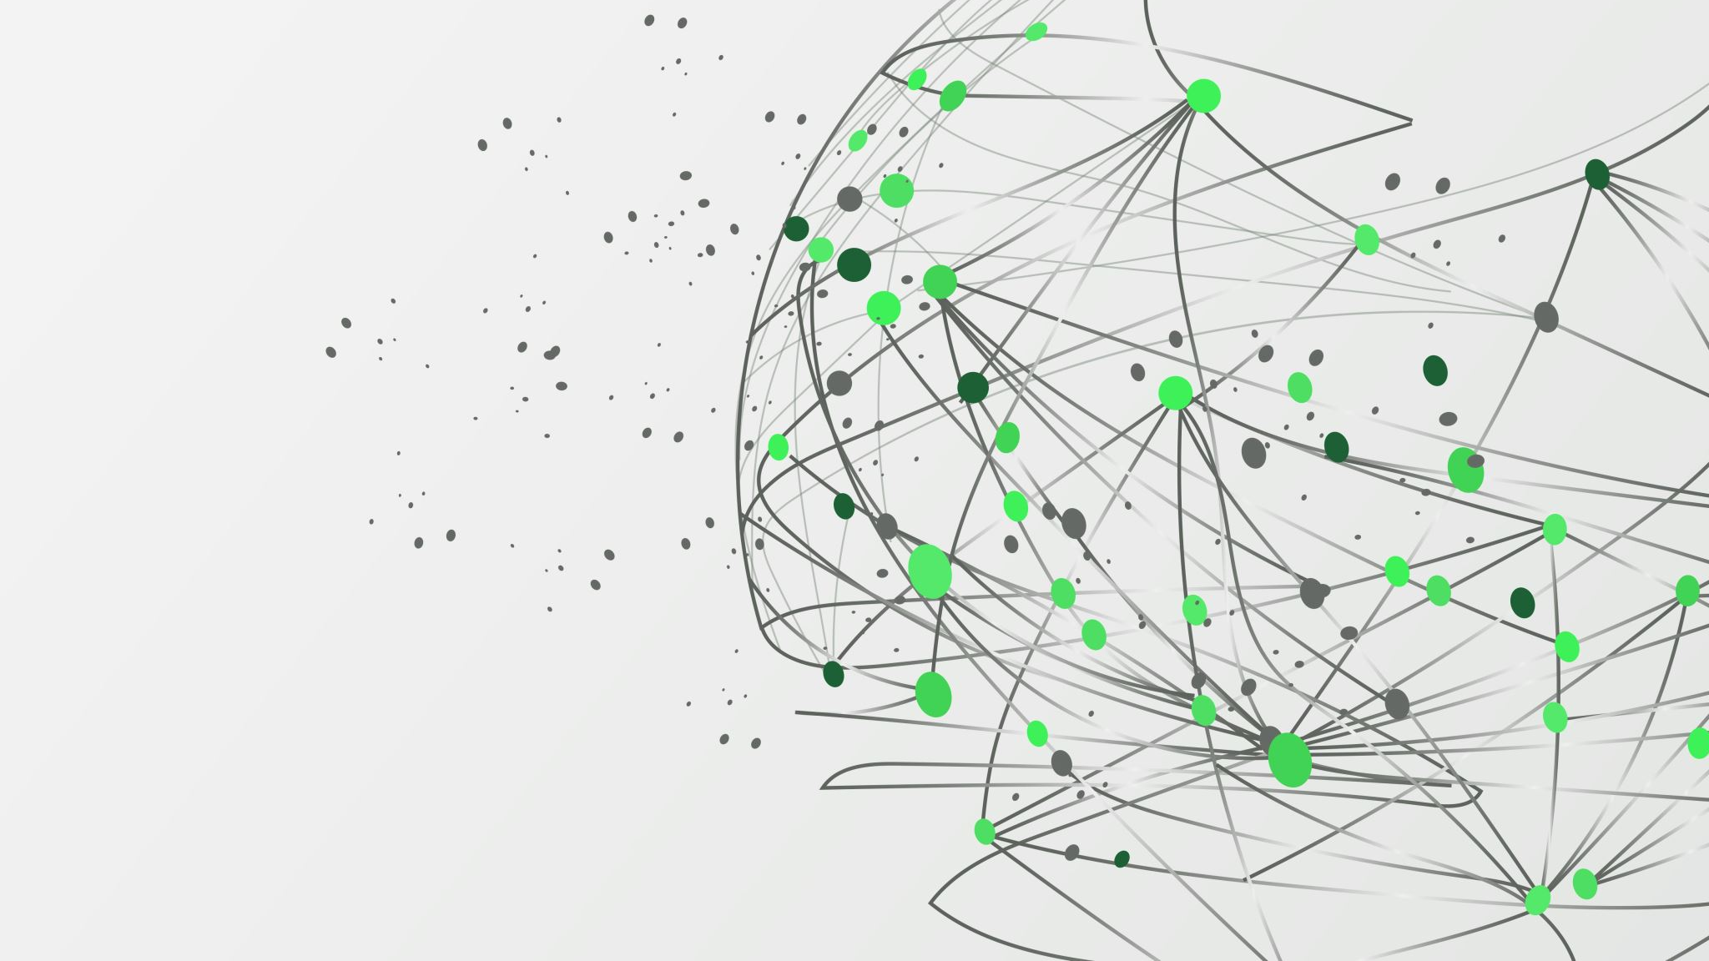
AI for Bengali Language Grapheme Classification
Team – Avengers
Aarthi, Sukirti, Vikas

Slide 2
Project and hypothesis
Build ML model which is capable of classifying different components of a Bengali Grapheme which can be used in OCR system, conversational AI for Bengali language.
Bengali is the 5th most spoken language in the world. So, there is significant business and educational interest in developing AI that can optically recognize images of the handwritten language.

Slide 3
Grapheme
Smallest meaningful unit in a writing system.
A grapheme is a letter or a number of letters that represent a sound (phoneme) in a word. Another way to explain it is to say that a grapheme is a letter or letters that spell a sound in a word.
Bengali is complex
Made up of 11 vowels, 7 consonants and 168 grapheme roots resulting in ~13000 different character variations.

Slide 4
Contd.
Bengali grapheme has three components – a grapheme root, vowel diacritic, consonant diacritic.
Diacritic - a sign which when written above or below a letter indicates a difference in pronunciation.
Bangla graphemes are a combination of the following units:
Grapheme roots which can be vowels, consonants or conjuncts
Vowel Diacritics, i.e. ◌া, ি◌, ◌ী, ◌ু, ◌ূ, ◌ৃ, ĺ◌, Ļ◌, ĺ◌া, ĺ◌ৗ or Nil
Consonant Diacritics, i.e. ◌্য, ◌ų, ◌ঁ, ◌র্্য, ◌ų্য or Nil
Bengali NLP research
Widespread impact.

Slide 5
Data Collection
Done EDA on the dataset.
Visualizing the handwritten images.
Data augmentation

Slide 6
Model implementation
CNN – popular deep learning method conducting image classification.

Slide 7
Performance evaluation
Based on accuracy of the predicted labels.
Predicted results matching the ground truth.

